Slide 1
Urban Roads

Slide 2
Road Patterns
Rectangular or Block patterns
Radial or Star block pattern
Radial or Star Circular pattern
Radial or Star grid pattern
Hexagonal Pattern
Minimum travel Pattern

Slide 3
Urban Road Classification
ARTERIAL ROADS
SUB ARTERIAL
COLLECTOR
LOCAL STREET
CUL-DE-SAC
PATHWAY
DRIVEWAY

Slide 5
ARTERIAL
No frontage access, no standing vehicle, very little cross traffic.
Design Speed : 80km/hr
Land width : 50 – 60m
Spacing 1.5km in congested areas & 8km or more in sparsely developed areas.
Divided roads with full or partial parking
Pedestrian allowed to walk only at intersection

Slide 6
SUB ARTERIAL
Bus stops but no standing vehicle.
Less mobility than arterial.
Spacing for congested areaa : 0.5km
Sub-urban fringes : 3.5km
Design speed : 60 km/hr
Land width : 30 – 40 m

Slide 7
Collector Street
Collects and distributes traffic from local streets
Provides access to arterial roads
Located in residential, business and industrial areas.
Full access allowed.
Parking permitted.
Design speed : 50km/hr
Land Width : 20-30m

Slide 8
Local Street
Design Speed : 30km/hr.
Land Width : 10 – 20m.
Primary access to residence, business or other abutting property
Less volume of traffic at slow speed
Origin and termination of trips.
Unrestricted parking, pedestrian movements. (with frontage access, parked vehicle, bus stops and no waiting restrictions)

Slide 9
CUL–DE- SAC
Dead End Street with only one entry access for entry and exit.
Recommended in Residential areas only

Slide 10
Factors Influencing Highway Alignment and Planning
Requirements:
Short
Easy
Safe
Economical
Factors controlling alignment :
Obligatory points
A. Obligatory points through which alignment is to pass ( bridge site, intermediate town , Mountain pass etc
B. Obligatory points through which alignment should not pass.
2) Traffic
3) Geometric design
4) Economics
5) Other considerations
Additional care in hill roads
Stability
Drainage
Geometric standards of hill roads
Resisting length

Slide 11
Road Functions
Mobility
Accessibility

Slide 12
Hierarchical Structure of Road Networks
Rural
Urban

Slide 13
Expressways/Motorway
Heavy traffic at high speed (120km/hr)
Land Width (90m)
Full access control
Connects major points of traffic generation
No slow moving traffic allowed
No loading, unloading, parking except dedicated places.

Slide 14
National Highways
Pakistan has a huge network of national highways.
The national highways have a total length of 70,548 kms. Indian highways cover 2% of the total road network of India and carry 40% of the total traffic.
The entire highway network of India is managed by the National Highway Authority of India which is responsible for development and maintenance of highways. The longest highway in India is NH7 which stretches from Varansi in Uttar Pradesh to Kanyakumari in the southern most point of Indian mainland.
The shortest highway is NH47A which stretches from Ernakulam to Kochi and covers total length of 4 Kms.

Slide 15
National Highways
The National Highways of Pakistan are a network of highways in Pakistan that are distinct from its motorways.
The main difference between the two are that, unlike motorways, national highways are not controlled-access or limited access. As in the case of motorways,
Pakistan's National Highway Authority owns, maintains and operates all national highways.
Pakistan's National Highways include famous highways such as the Grand Trunk Road, the Indus Highway, the Karakoram Highway and the Makran Coastal Highway
All National Highways in Pakistan are pre-fixed with the letter 'N' (for "National") followed by the unique numerical designation of the specific highway (with a hyphen in the middle), e.g. "N-5". Each numerical designation is separated by five numerals, i.e. N-5, N-10, N-15, etc.

Slide 16
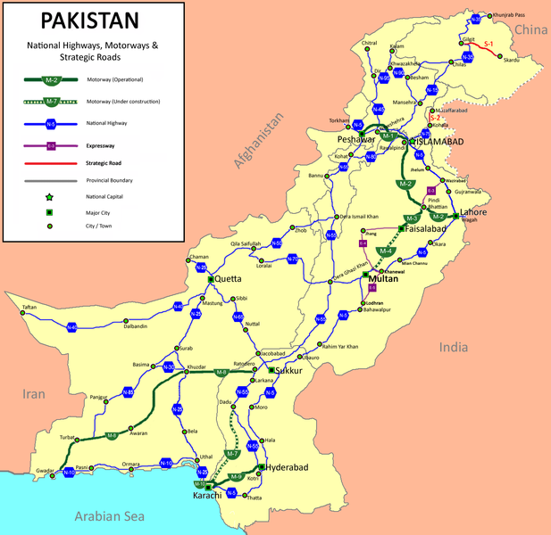

Slide 17
The Motorways of Pakistan are a network of high-speed, limited-access or controlled-access highways in Pakistan, which are owned, maintained and operated federally by Pakistan's National Highway Authority

Slide 18
Highway Components Cross-section

Slide 19
Highway Components Urban Intersections

Slide 20
Highway Components Rural Intersections

Slide 21
Highway Components Interchanges

